Slide 1
Software Engineering
Lecture 3

Slide 2
Software Product
Software is a set of items or objects that form a “configuration” that includes
Programs that when executed provide desired function and performance
Data structures that enable programs to adequately manipulate information
Documents that describe the operation and use of the programs

Slide 3

What is Failure, Error and Faults?
Error – a human action that produces an incorrect result. This is also sometimes referred to as Mistake.
Fault – a manifestation of an error in software, also known as Defect or Bug.
Failure – a deviation of the software from its expected delivery or service.
Notes:
In other words:
Fault : It is a condition that causes the software to fail to perform its required function.
Error : Refers to difference between Actual Output and Expected output.
Failure : It is the inability of a system or component to perform required function according to its specification.

Slide 4
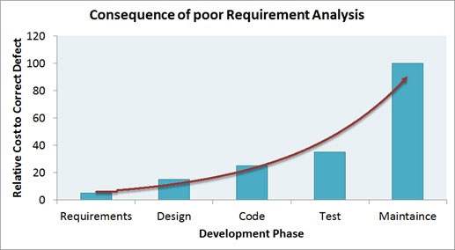
Relative Cost to Correct Defects

Slide 5
The software process
A structured set of activities required to develop a software system.
Many different software processes but all involve:
Specification – defining what the system should do;
Design and implementation – defining the organization of the system and implementing the system;
Validation – checking that it does what the customer wants;
Evolution – changing the system in response to changing customer needs.
A software process model is an abstract representation of a process. It presents a description of a process from some particular perspective.

Slide 6
Software process descriptions
When we describe and discuss processes, we usually talk about the activities in these processes such as specifying a data model, designing a user interface, etc. and the ordering of these activities.
Process descriptions may also include:
Products, which are the outcomes of a process activity;
Roles, which reflect the responsibilities of the people involved in the process;
Pre- and post-conditions, which are statements that are true before and after a process activity has been enacted or a product produced.

Slide 7
Plan-driven and agile processes
Plan-driven processes are processes where all of the process activities are planned in advance and progress is measured against this plan.
In agile processes, planning is incremental and it is easier to change the process to reflect changing customer requirements.
In practice, most practical processes include elements of both plan-driven and agile approaches.
There are no right or wrong software processes.

Slide 8
Software Process
Software process is the way software is produced. When you build a product, it is important to go through a series of predictable steps, a roadmap that helps you create a high quality product, in a timely manner.
On the other hand, Software engineering also encompasses technologies that populate the process –technical methods and tools
Methods provide the technical HOW TO for building software
Tools provide automated or semi-automated support for the process and the methods
Software process is the glue

Slide 9
Process activities
Real software processes are inter-leaved sequences of technical, collaborative and managerial activities with the overall goal of specifying, designing, implementing and testing a software system.
The four basic process activities of specification, development, validation and evolution are organized differently in different development processes.
For example, in the waterfall model, they are organized in sequence, whereas in incremental development they are interleaved.

Slide 10
Software Process Phases
1
Requirements Analysis Phase
2
Specification Phase
3
Design Phase
4
Implementation Phase
5
Integration Phase (in parallel with phase 4)
6
Maintenance Phase

Slide 11
Software Process Phases
Requirements Analysis phase
Specification phase
Design phase
Implementation phase
Integration phase (in parallel with 4)
Maintenance phase
Testing and documentation are activities that take place through all phases

Slide 12
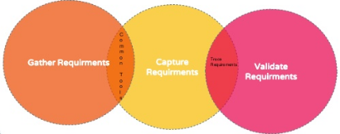
Requirements Phase

Slide 13
Requirements Phase
(1) Requirements Gathering (Elicitation)
The most important phase of the SDLC is the requirement gathering and analysis phase
This is when the project team begins to understand what the customer wants from the project.
During the requirements gathering sessions, the project team meets with the customer to outline each requirement in detail.

Slide 14
Requirements Phase (contd.)
(2) Requirements Capturing:
Capturing Data Requirements
Information to be stored
Capturing Functionality Requirements
Examples include: “add customer” and “print invoice”
Capturing Quality Attributes
Performance
Security
Availability
Usability

Slide 15
Requirements Phase (contd.)
(3) Validate Requirements: Through Rapid Prototyping
Software that incorporates much of the functionality of the target product but omits aspects invisible to the client (e.g. file updating or exception handling)
Client and users experiment with the prototype to determine whether it meets their needs
(4) Deliverable: Requirements document
Checked by the client, selected users, and the development team

Slide 16
The requirements engineering process

Slide 17
Software Process Phases
Requirements phase
Specification phase→ What?
Design phase
Implementation phase
Integration phase (in parallel with 4)
Maintenance phase
Testing and documentation are activities that take place through all phases

Slide 18
Software specification
The process of establishing what services are required and the constraints on the system’s operation and development.
Requirements engineering process
Requirements elicitation and analysis
What do the system stakeholders require or expect from the system?
Requirements specification
Defining the requirements in detail
Requirements validation
Checking the validity of the requirements

Slide 19
Specification Phase
Specifications document (or specifications)
Exactly describes the functionality of the product
Lists any constraints that the product have
Includes the inputs to the product and the required outputs
Specifications must not be:
Ambiguous: open to more than one interpretation; not having one obvious meaning.
Incomplete: not having all the necessary or appropriate parts
Contradictory: mutually opposed or inconsistent.

Slide 20
Specification Phase (contd.)
Once the specifications are complete, detailed planning and estimating begins
How long it will take
How much it will cost
Resources needed
Milestones: when the client gets them
Deliverables: what the client is going to get
Software Quality Assurance (SQA) group must check the specifications carefully
Look for contradictions, ambiguities, and incompleteness
Ensure that the specifications are feasible
Trace every statement of the specification back to the requirements document and rapid prototype
Check by review – Done by SQA, specification team, and client

Slide 21
Specification Phase (contd.)
Example of ambiguous requirement:
All customers have the same control field
All customers have the same value in their control fields
All customers control fields have the same format
One control field is issued for all customers
Example of Contradictory requirement:
Landing gear must be present on an airplane in order to land and takeoff.
It should not be present during flight because of an increase in air drag.
The physical contradiction is that the landing gear must be both present and absent.
This contradiction is resolved by separating the requirements in time — make the landing gear retractable.

Slide 22
Software Process Phases
Requirements phase
Specification phase
Design phase → How?
Implementation phase
Integration phase (in parallel with 4)
Maintenance phase
Testing and documentation are activities that take place through all phases

Slide 23
Software design and implementation
The process of converting the system specification into an executable system.
Software design
Design a software structure that realises the specification;
Implementation
Translate this structure into an executable program;
The activities of design and implementation are closely related and may be inter-leaved.

Slide 24
A general model of the design process

Slide 25
Design activities
Architectural design, where you identify the overall structure of the system, the principal components (subsystems or modules), their relationships and how they are distributed.
Database design, where you design the system data structures and how these are to be represented in a database.
Interface design, where you define the interfaces between system components.
Component selection and design, where you search for reusable components. If unavailable, you design how it will operate.

Slide 26
Design Phase
(1) High-level design:
A graphical representation of the structure of your software system
A document that defines high-level details of each module in your system, including:
A module’s interface (including input and output data types)
Notes on possible algorithms or data structures the module can use to meet its responsibilities
A list of any non-functional requirements that might impact the module

Slide 27
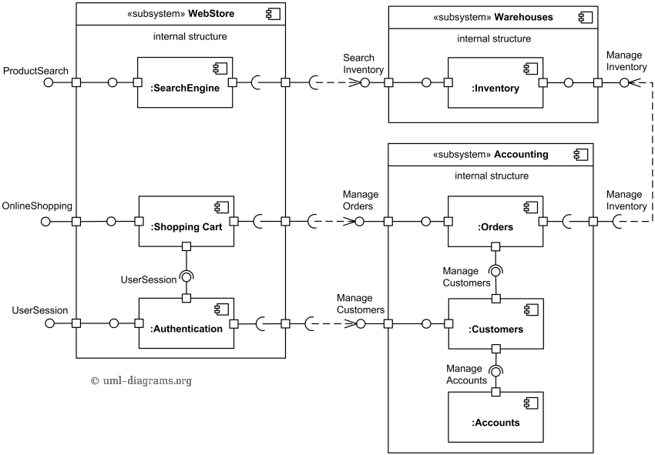
Architectural design example (Component)
Notes:
UML component diagrams are concerned with the components of a system.
Components are the independent, encapsulated units within a system or subsystem that provide one or more interfaces.
Component diagrams are used to visualize how a system’s pieces interact and what relationships they have among them.
Component diagrams are different from most other diagrams, as they show high-level structure and not details like attributes and methods.
Component diagrams are a static view of the software system, and depict the system design at a specific point in its development and evolution.

Slide 28
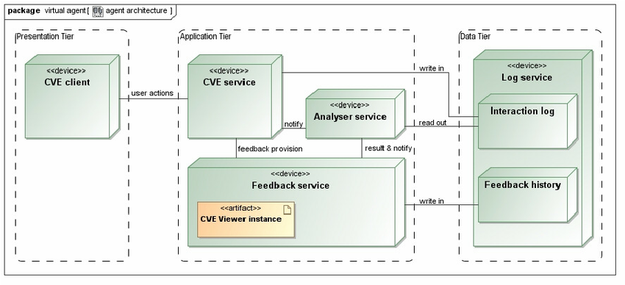
Architectural design example (Deployment)
Notes:
Deployment diagram falls under the structural diagramming family because it describes an aspect of the system itself.
The deployment diagram describes the physical deployment of information generated by the software program on hardware components.
The three-dimensional boxes, known as nodes, represent the basic software or hardware elements, or nodes, in the system.
Lines from node to node indicate relationships, and the smaller shapes contained within the boxes represent the software artifacts that are deployed.

Slide 29
Design Phase (contd.)
(2) Detailed Design:
After high-level design, a designer’s focus shifts to low-level design
Each module’s responsibilities should be specified as precisely as possible
Constraints on the use of its interface should be specified
pre and post conditions can be identified
module-wide invariants can be specified
internal data structures and algorithms can be suggested

Slide 30
Design Phase (contd.)
SQA group must check the design
Look for logic faults, interface faults, lack of exception handling, nonconformance to the specification
Trace every part of the design to a statement in specification document
Review by –SQA and design team
Documentation
architecture design
detailed design

Slide 31
Software Process Phases
Requirements phase
Specification phase
Design phase
Implementation phase
Integration phase (in parallel with 4)
Maintenance phase
Testing and documentation are activities that take place through all phases

Slide 32
System implementation
The software is implemented either by developing a program or programs or by configuring an application system.
Design and implementation are interleaved activities for most types of software system.
Programming is an individual activity with no standard process.
Debugging is the activity of finding program faults and correcting these faults.

Slide 33
Implementation Phase
Implement the detailed design in code
Testing
Code review
Running test cases
Informal testing done by the programmer (desk checking)
Testing by SQA group
Documentation
Source code with suitable comments
Test cases against which the code was tested

Slide 34
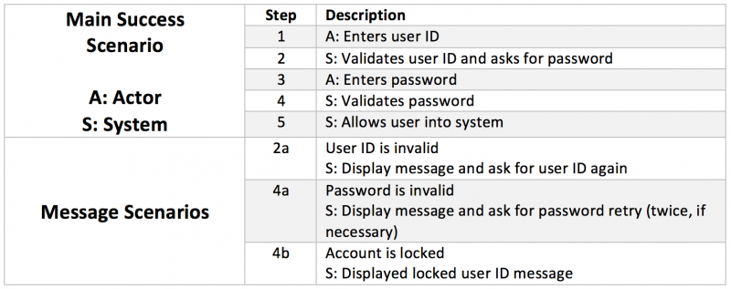
Test Case Scenario Example

Slide 35
Software Process Phases
Requirements phase
Specification phase
Design phase
Implementation phase
Integration phase (in parallel with 4)
Maintenance phase
Testing and documentation are activities that take place through all phases

Slide 36
Integration Phase
Integrate the modules –performed in parallel with implementation
Integration testing
Testing module interfaces
Product testing – SQA group
Correctness: the quality or state of being free from error.
Robustness: the degree to which a system or component can function correctly in the presence of invalid inputs or stressful environmental conditions.
Acceptance testing – client
After the software has been delivered, the customer performed the acceptance testing to determine whether to accept the delivered software or to reject it.
Notes:
Correctness properties refer to expected behavior
Robustness behaviors in unexpected conditions (ex: when a user recovers from a system error that caused the word-processor to crash)

Slide 37
Integration Phase (contd.)
Once the product testing is complete, the software is supplied to selected possible future users for testing on site – alpha version
Corrected alpha version is called beta version
Documentation
Commented source code
Test cases for the product as a whole
User manual, operator manual, database manual

Slide 38
Software Process Phases
Requirements phase
Specification phase
Design phase
Implementation phase
Integration phase (in parallel with 4)
Maintenance phase
Retirement
Testing and documentation are activities that take place through all phases

Slide 39
Approximate Relative Cost of Each Phase
Maintenance constitutes 67% of total cost

Slide 40
Maintenance Phase
Maintenance - any change once the client has accepted the software
Different types of maintenance:
Adaptive – modifying the system to cope with changes in the software environment (DBMS, OS)
Perfective – implementing new or changed user requirements which concern functional enhancements to the software
Corrective – diagnosing and fixing errors, possibly ones found by users
Preventive – increasing software maintainability or reliability to prevent problems in the future

Slide 41
Maintenance Phase (contd.)
Common problem – not updated documentation or lack of documentation
Regression testing – the product must be tested against previous test cases to make certain that the functionality of the rest of the product has not been compromised
Documentation
Record of all the changes made, together with reasons
Regression test cases

Slide 42
Software Process Phases
Requirements phase
Specification phase
Design phase
Implementation phase
Integration phase (in parallel with 4)
Maintenance phase
Testing and documentation are activities that take place through all phases

Slide 43
Software validation
Verification and validation (V & V) is intended to show that a system conforms to its specification and meets the requirements of the system customer.
Involves checking and review processes and system testing.
System testing involves executing the system with test cases that are derived from the specification of the real data to be processed by the system.
Testing is the most commonly used V & V activity.

Slide 44
Stages of testing

Slide 45
Testing stages
Component testing
Individual components are tested independently;
Components may be functions or objects or coherent groupings of these entities.
System testing
Testing of the system as a whole. Testing of emergent properties is particularly important.
Customer testing
Testing with customer data to check that the system meets the customer’s needs.

Slide 46
Testing phases in a plan-driven software process (V-model)

Slide 47
Software evolution
Software is inherently flexible and can change.
As requirements change through changing business circumstances, the software that supports the business must also evolve and change.
Although there has been a demarcation between development and evolution (maintenance) this is increasingly irrelevant as fewer and fewer systems are completely new.

Slide 48
System evolution

